Slide 1

Object Oriented Programming with C#
CS107.3
Lecture #02
Pramudya Thilakaratne pramudya.h@nsbm.ac.lk
Lecturer
Faculty of Computing
NSBM Green University

Slide 2
Welcome to Lecture 02!
Take your notebooks and prepare
You can ask questions via either chat message or over the mic.
When you are not using the mic please mute it.

Slide 3

From Last Week
Basic Concepts of C#

Slide 4
Basic Operators
An Operator is a symbol that tells the compiler to perform specific mathematical or logical manipulations
C# has rich set of built in operators and provides the following type of operators
Arithmetic Operators
Relational operators
Logical Operators
Assignment Operators

Slide 5
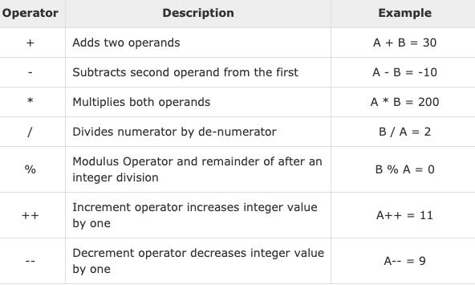
Arithmetic Operators
If
int A = 10;
&
int B = 20;

Slide 6
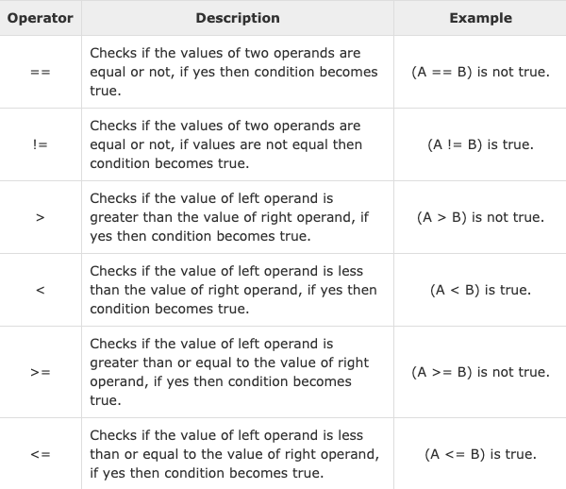
Relational Operators
If
int A = 10;
&
int B = 20;

Slide 7
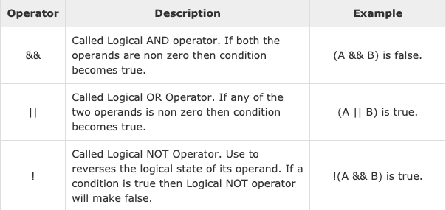
Logical
Operators
If
int A = 10;
&
int B = 20;

Slide 8
C# Loops
There may be situation, when you need to execute a block of code several number of times.
In general, the statements are executed sequentially; The first statement in a function is executed first, followed by the second and so on.
C# provides following types of loop to handle looping requirement.
01. while loop
02. for loop
03. do while loop
04. nested loops

Slide 9
C# Loop Control Statements
Break Statement
Terminate the loop or switch statement and transfer executions to the statement
immediately following the loop or switch.
Syntax
break;
Continue statement
Cause the loop to skip the remainder of its body and immediately retest its
condition prior to reiterating.
Syntax
continue;

Slide 10
C# Access Specifiers / Modifiers
All types and type members have an accessibility level, which controls whether they can
be used from another code in your assembly or other assemblies.
public The type or member can be accessed by any other
code in the same assembly or another assembly that references it.
private The type or member can be accessed only by code in the same class or struct.
protected The type or member can be accessed only by
code in the same class, or in a class that is derived from that class.

Slide 11
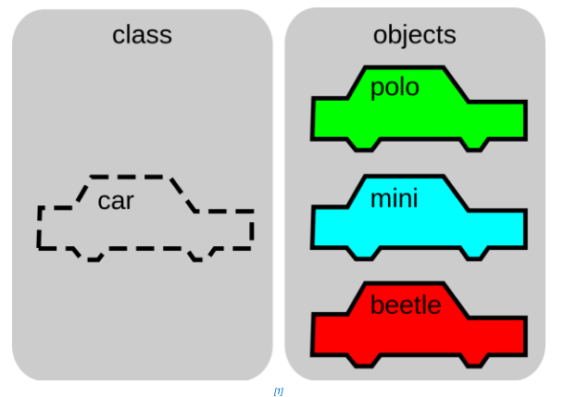
C# Class
In Object Oriented Programming, a class is a blueprint for creating objects (a particular data
Structure), providing initial values for state (member variables or attributes), and implementations
Of behaviors (member functions or methods).

Slide 12
How to Create / Add a class file in VS
Right click on your project file in solution explorer.
Click on add, New item
From the selection window you have to select C# Class file
Rename the class file with .cs file extension.
Eg - MyClass.cs
Remember – A Class name can be anything but not a reserved word & not allowed to keep spaces in class name.

Slide 13
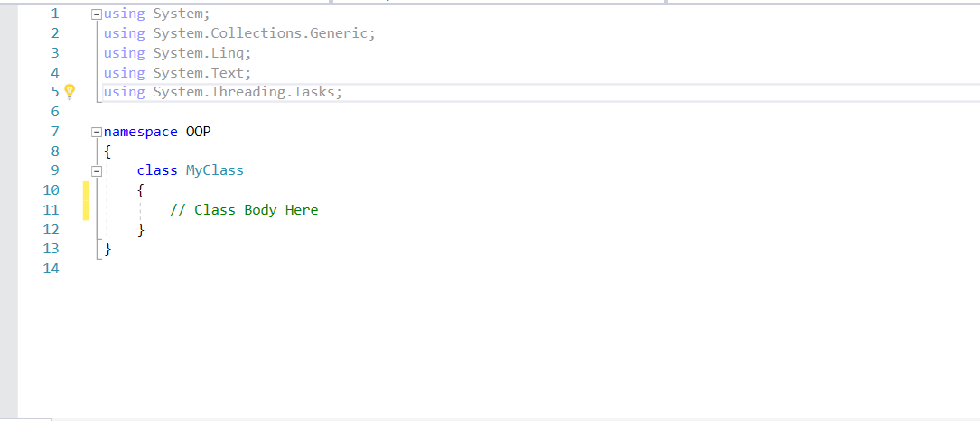
C# Class

Slide 14
C# Class
A Class definition starts with the keyword class followed by the class name.
And the class body enclosed with pair of curly brackets.

Slide 15
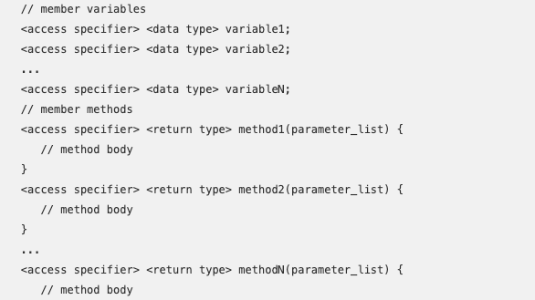

Slide 16
Accessing the added class from another class
When you create a C# console application program the main method of the project is existing in program.cs class also known as main class.
When you run the program compiler is looking at the instruction inside the main method. (similar as the C programming language).
If you have added a new class file to your project you need to call your added class from
main method.
To do that in OOP languages we are using something call class object also know as an object.

Slide 17
How to create an Object
Class_Name <Space> Object_Name = new <Space> Class_Name( );

Slide 18
Accessing the added class from another class
Example
Program.cs
(main class)
MyClass.cs
Assume that user have created a C# Console application and
add a class to the same project call MyClass.
Inside MyClass class there is a function (method) call Hello( ) as well.
(No return type no parameter function)

Slide 19
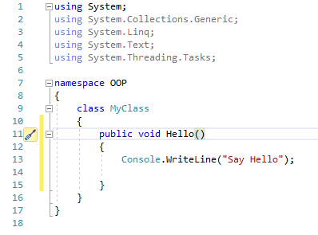
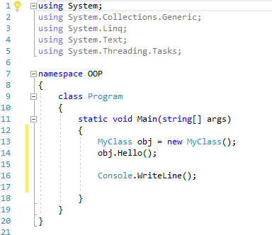
MyClass.cs
Program.cs

Slide 20
Task 01
Create a C# Console application program to get user information and display a greeting message as following
Hello username welcome & you are age old.
Instructions
You should get user input in a separate class.
User Inputs – Name & Age of the user
Create a class object in main class (Program.cs) and call the function.
Display the above mention output in console application.

